Slide 1
Space Environment Mod (Minecraft Modding)
By Leo Liu

Slide 2
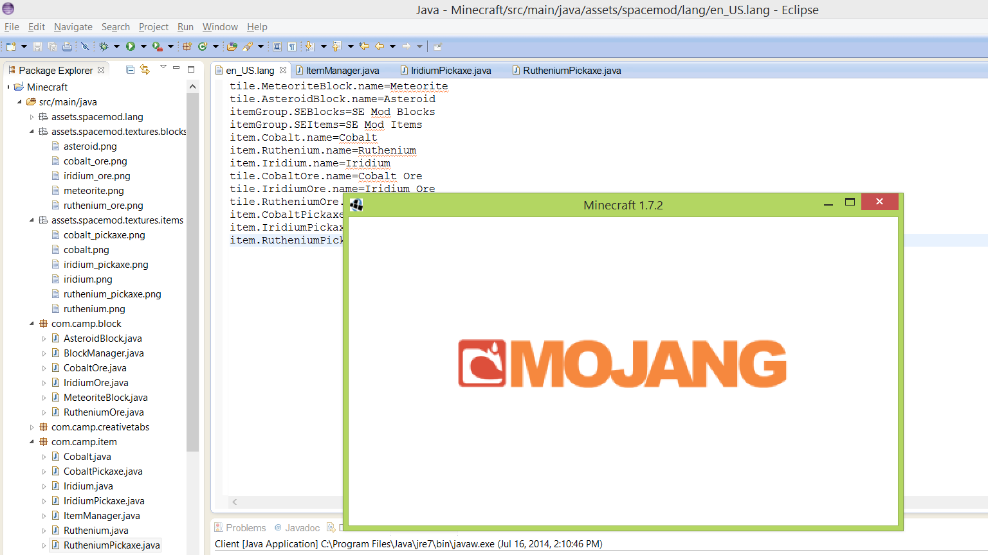
I was naming all of my items.

Slide 3
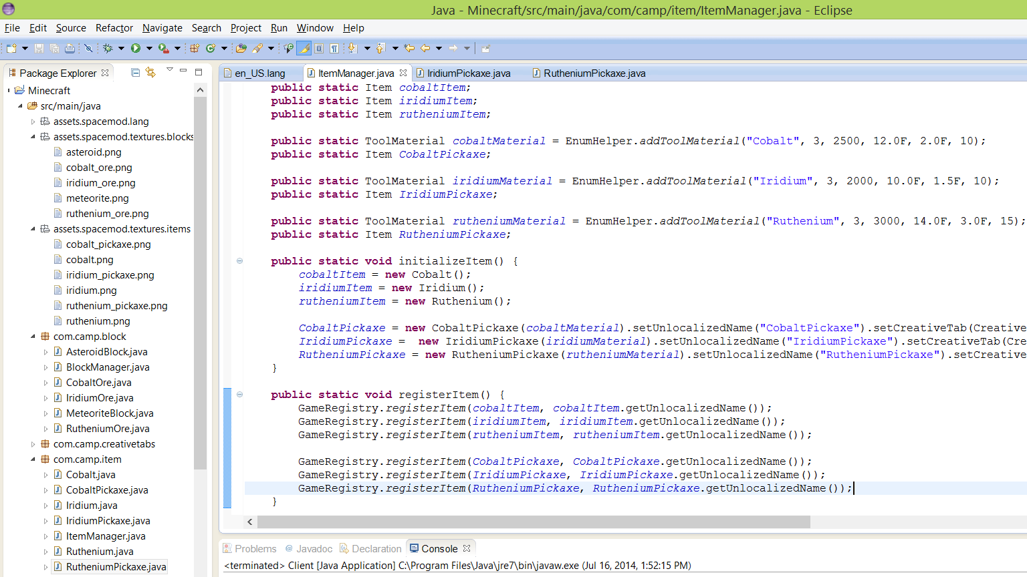
Code for all of my items

Slide 4
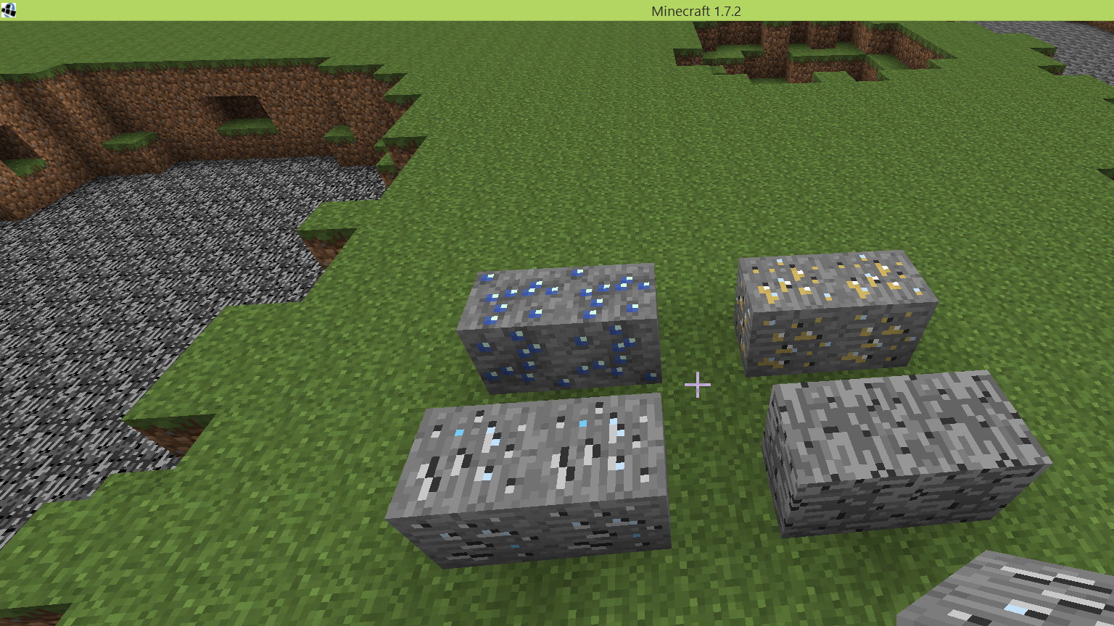
The Ores; Iridium, Cobalt, and Ruthenium, as well as the Asteroid block

Slide 5
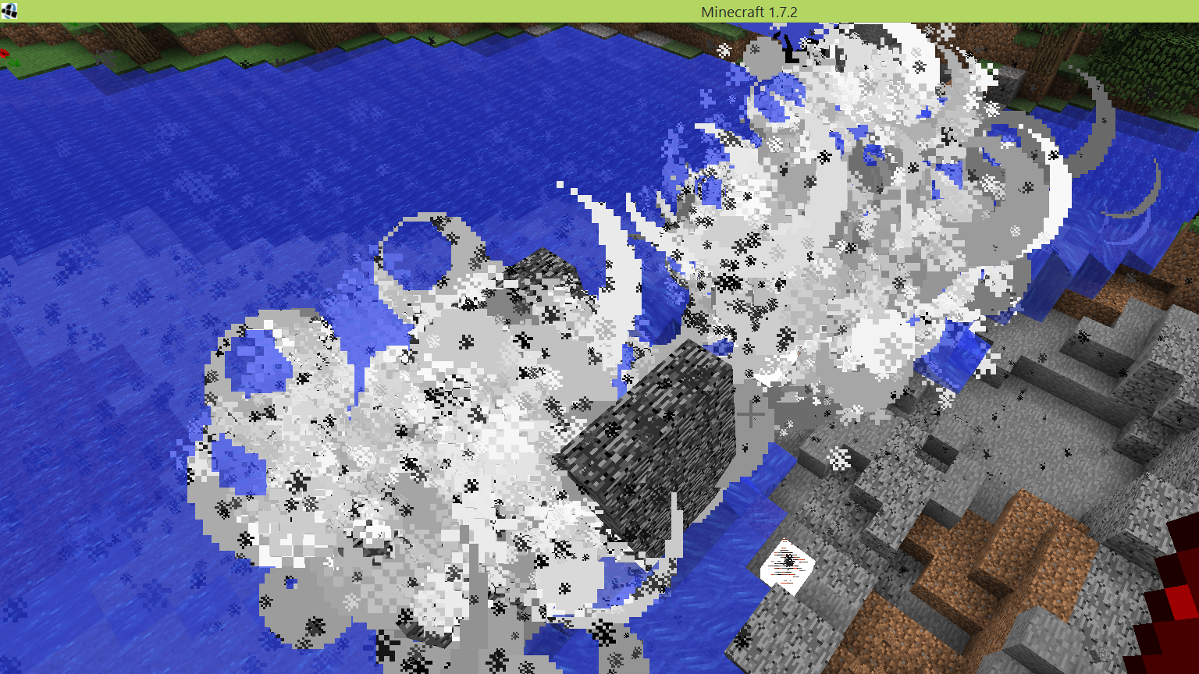
My TNT Cannon (for fun).

Slide 6
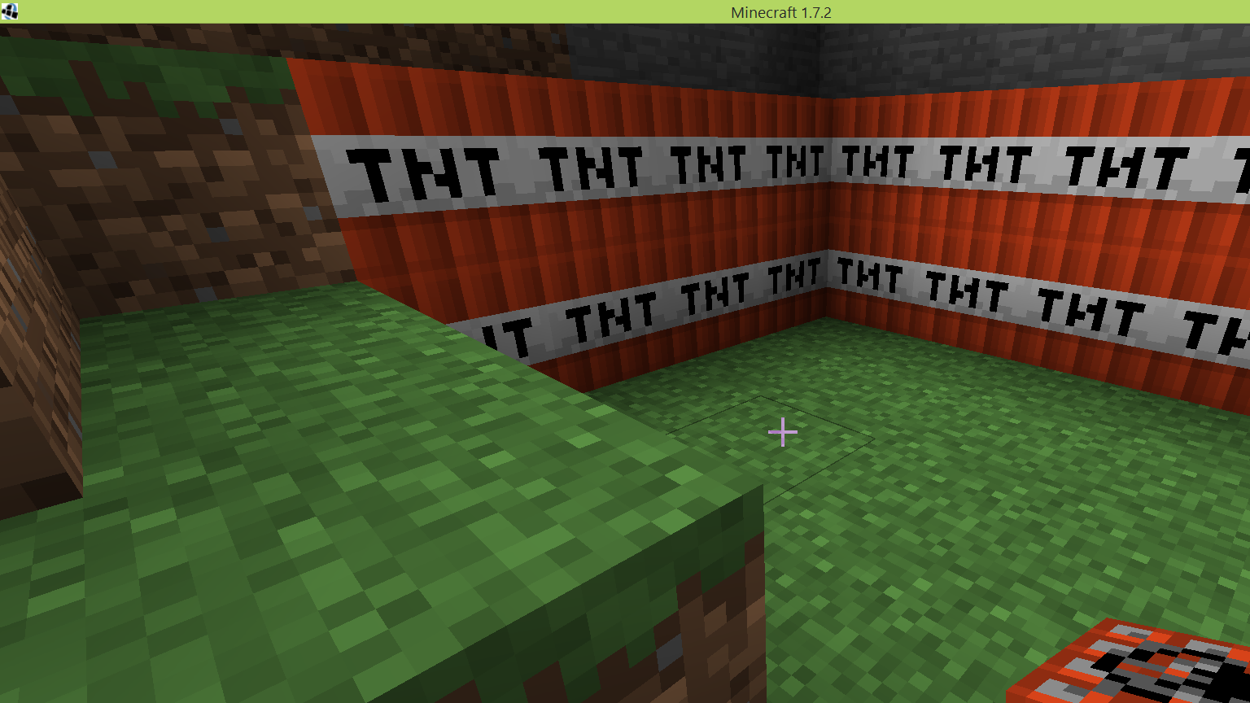
More TNT

Slide 7
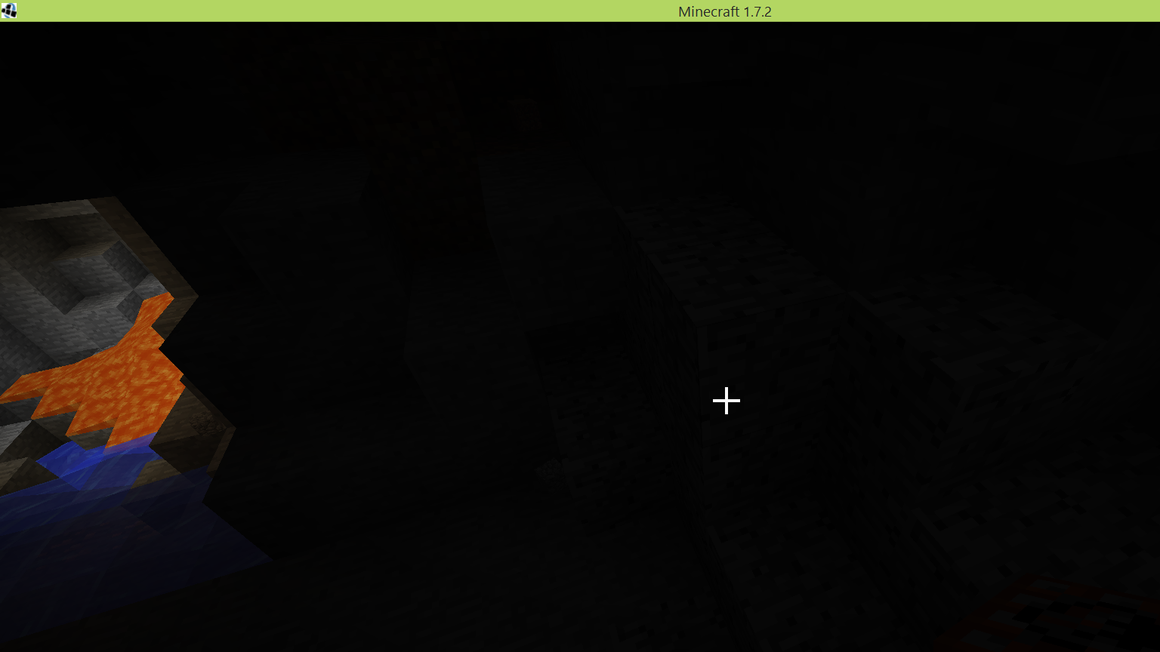

Slide 8
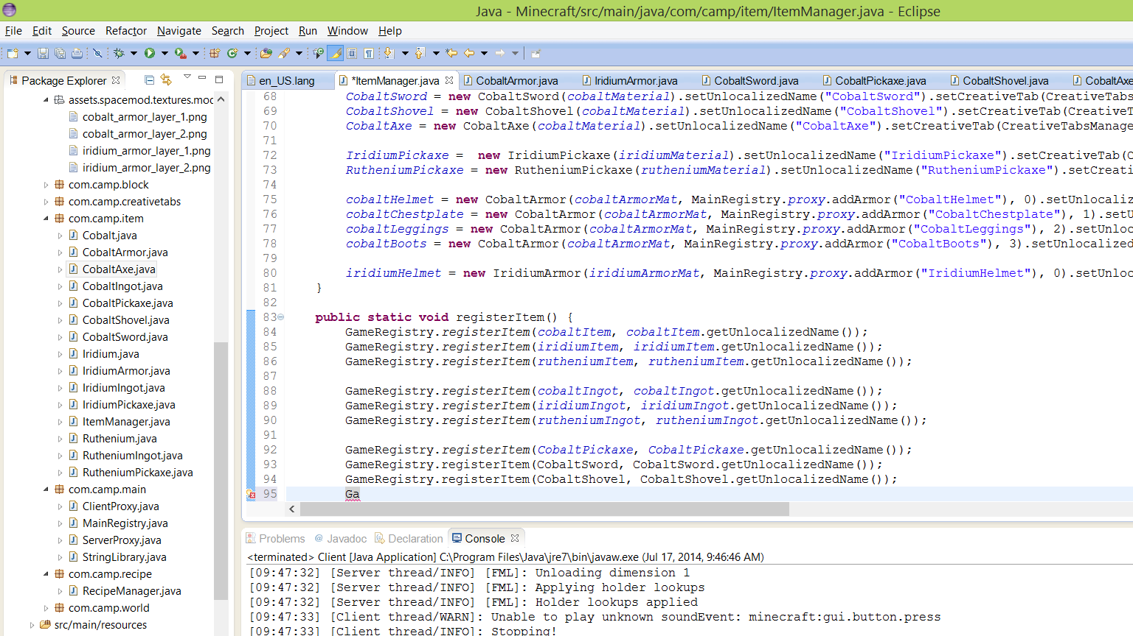

Slide 9
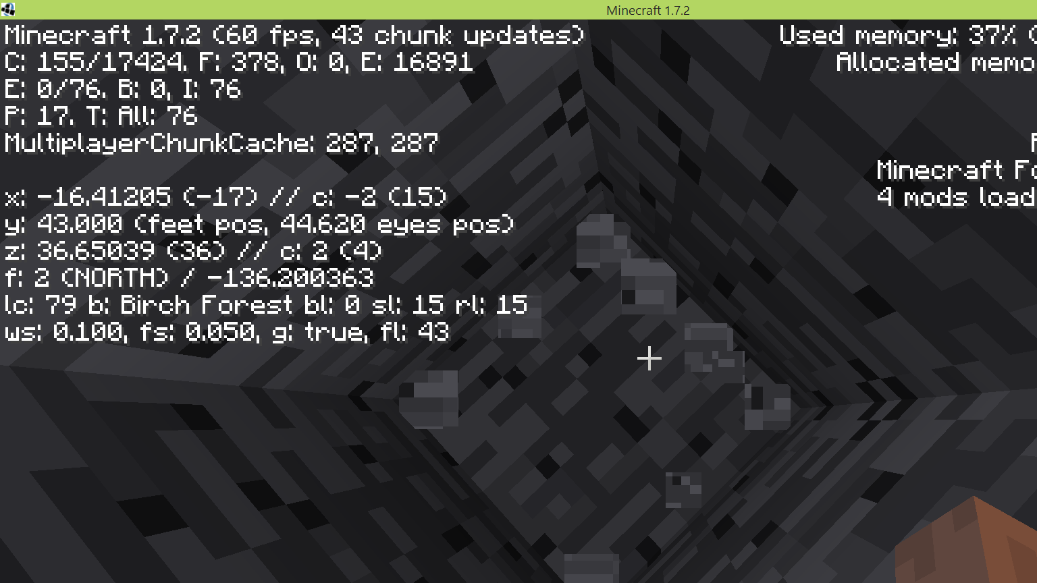
Testing Ore Generation and searching for my Ores

Slide 10
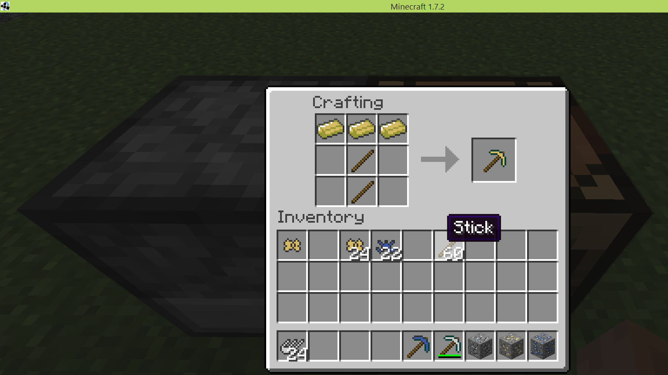
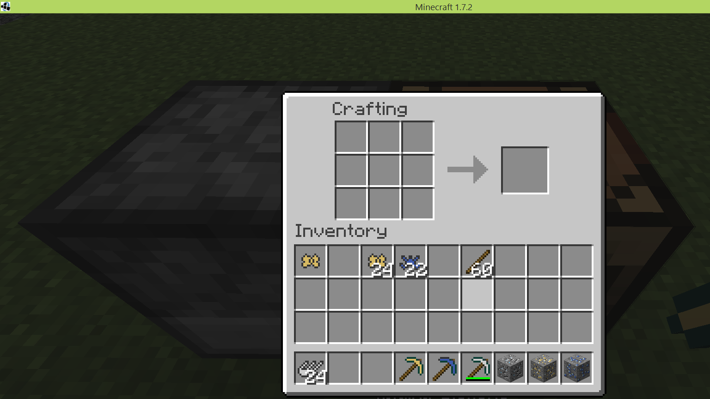
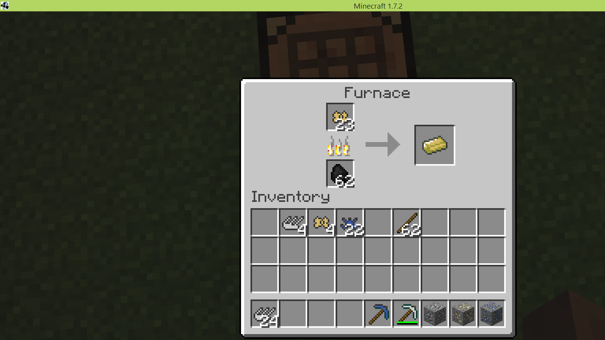
Smelting/Crafting Recipes for the minerals

